Slide 1
Solar Car Recruitment and Retention
Will Jones
Date: Jan 18th, 2025

Slide 2
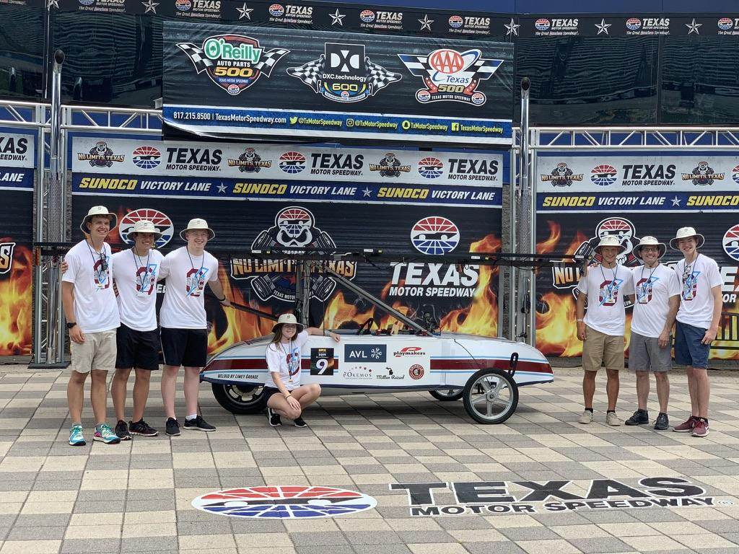
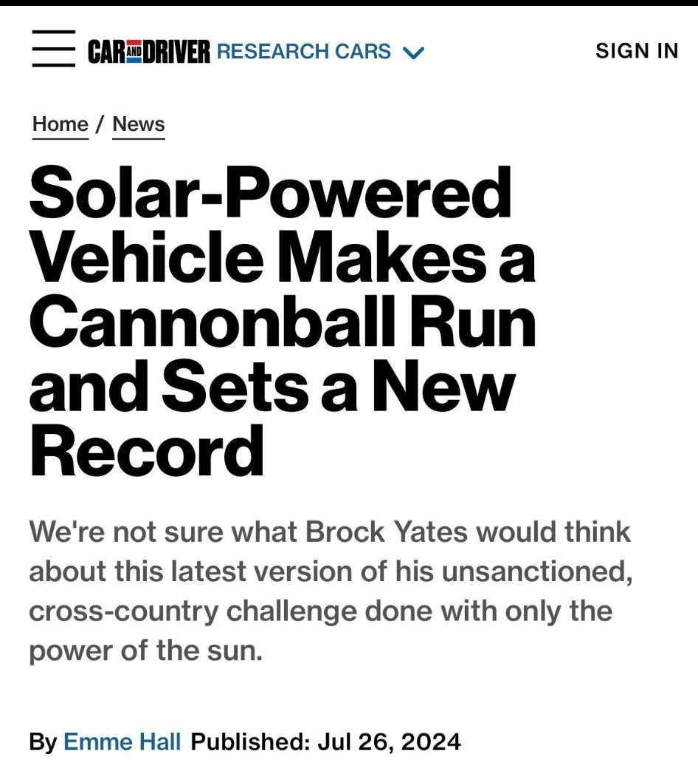
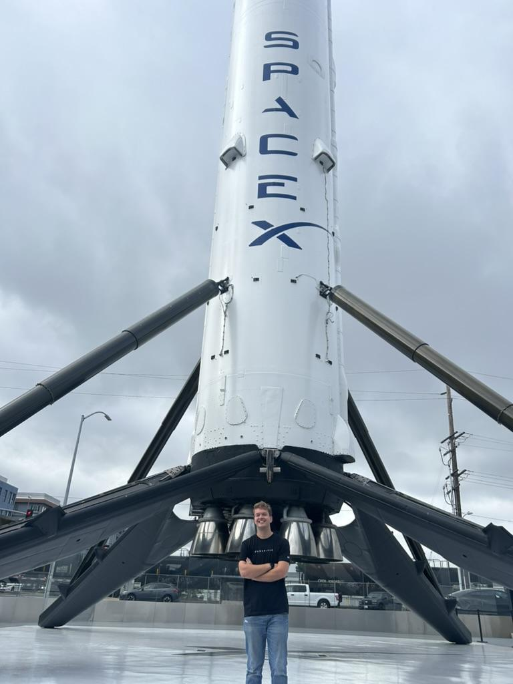
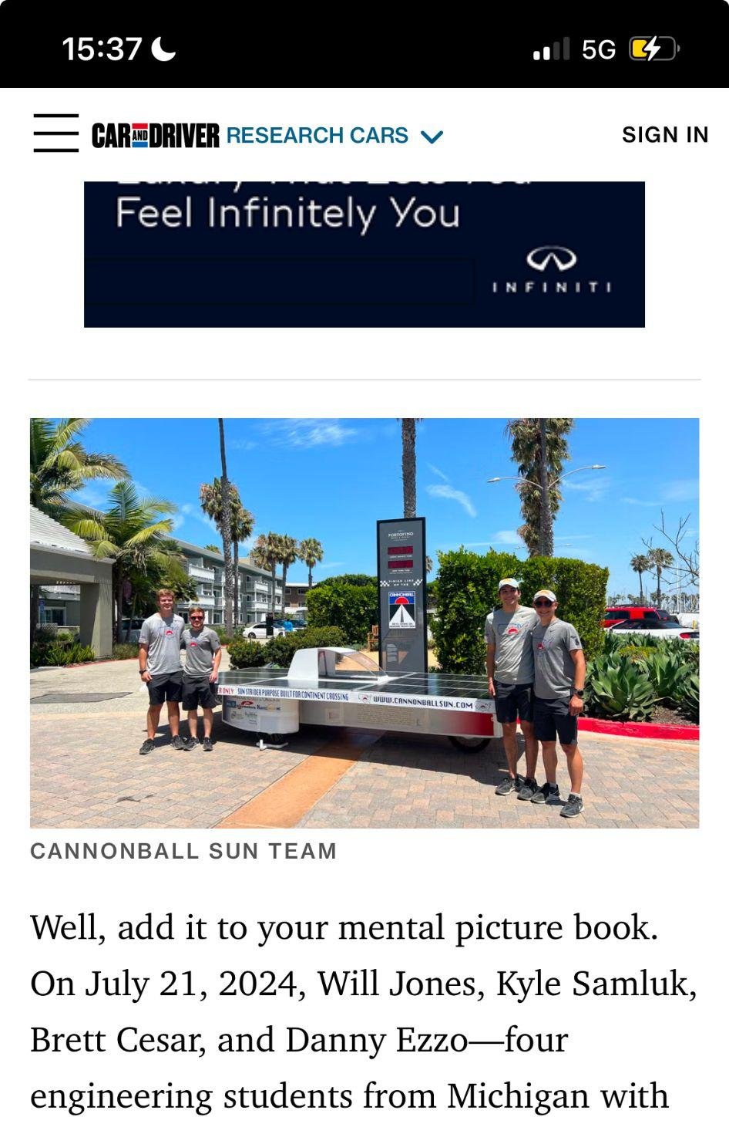
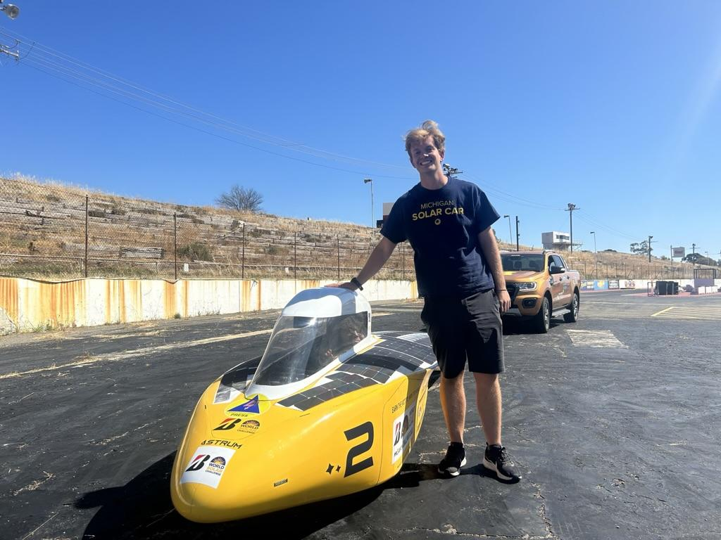
About me
Notes:
Get better pic of Car and Driver

Slide 3
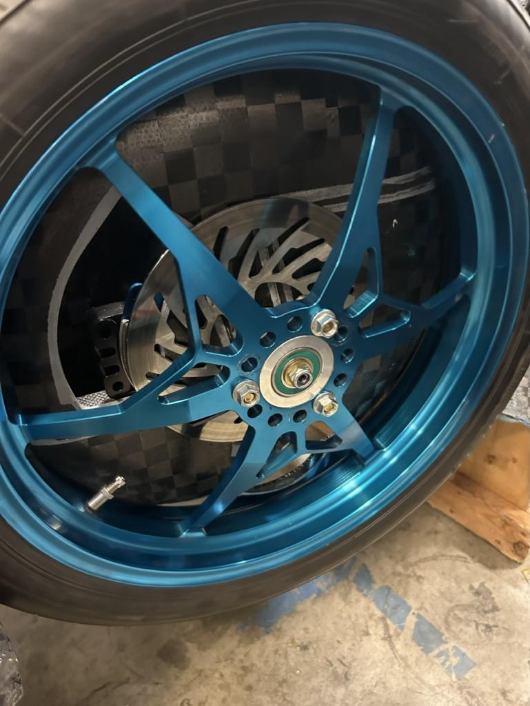
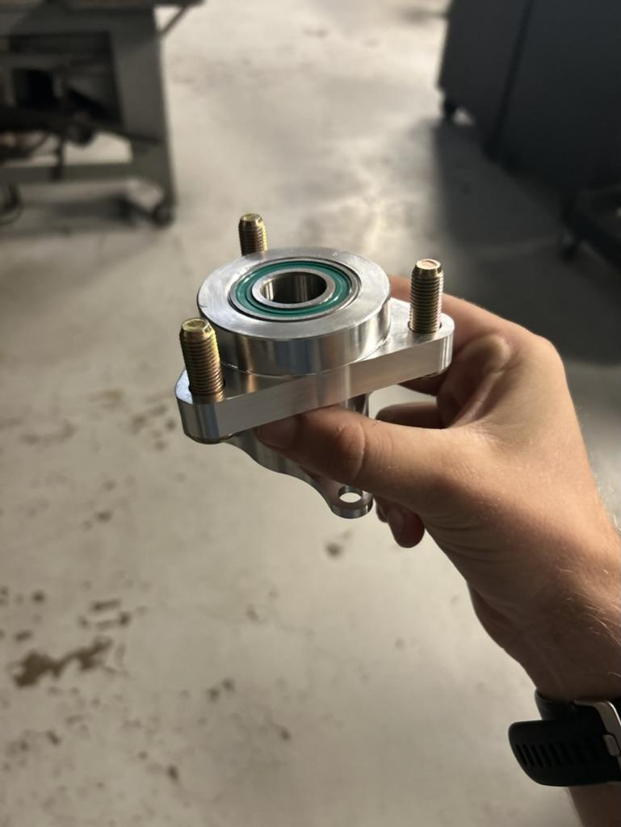
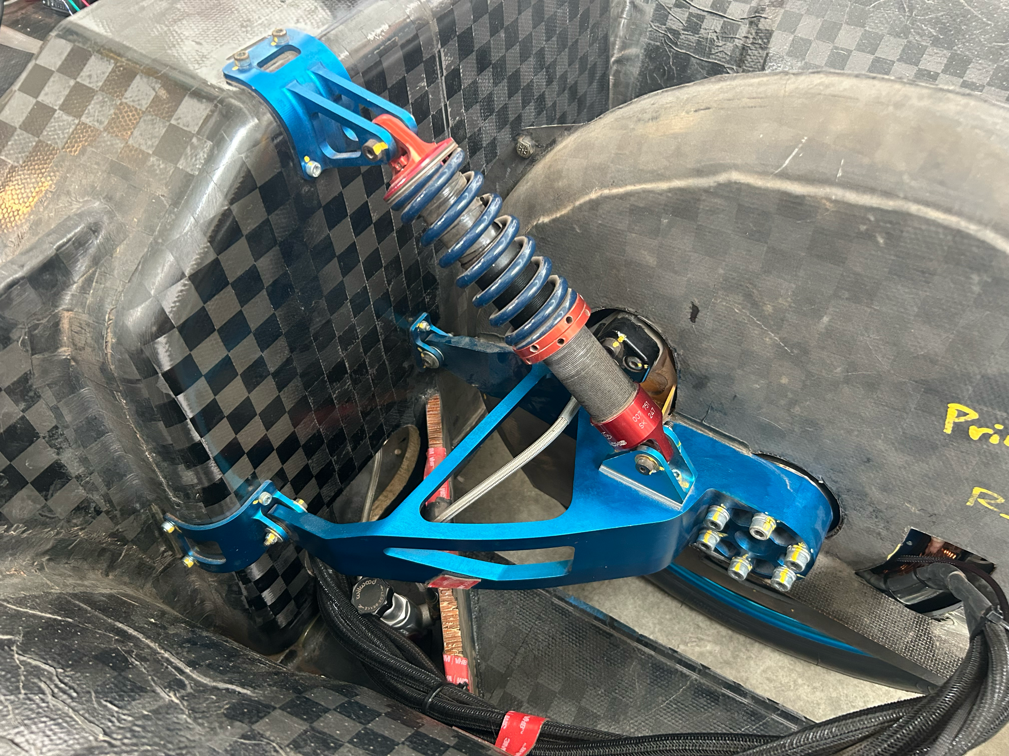

Slide 4
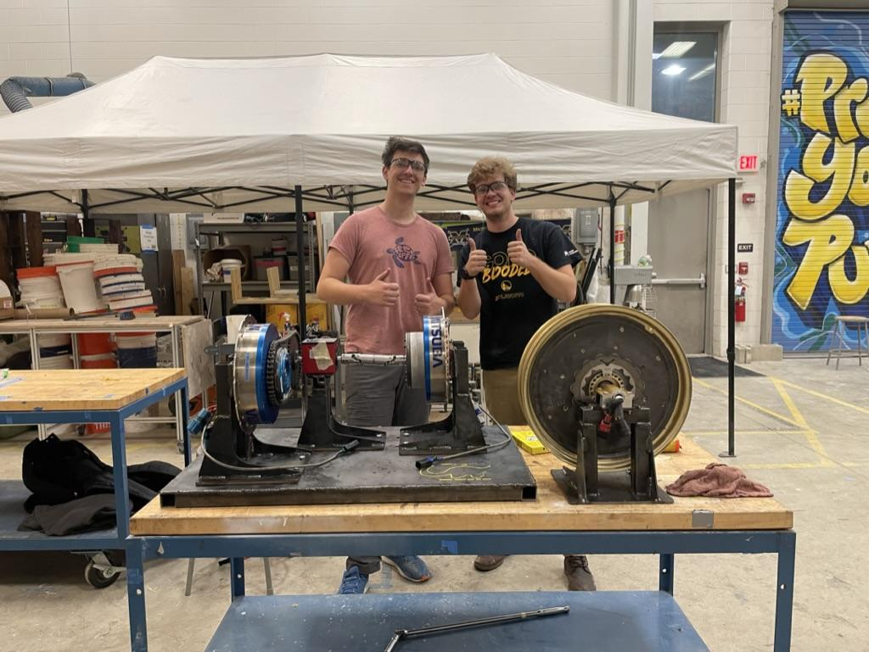
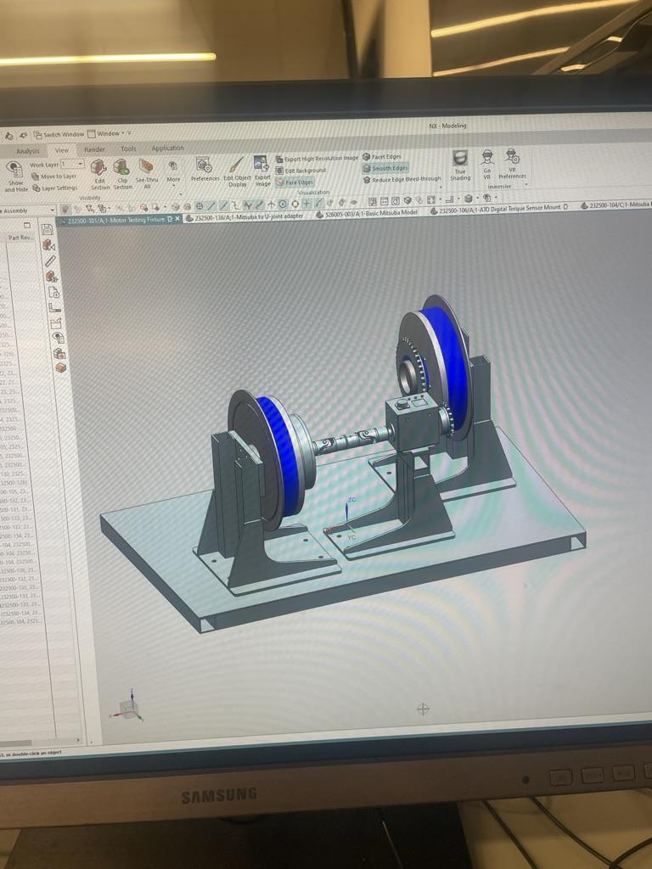
Motor dyno

Slide 5
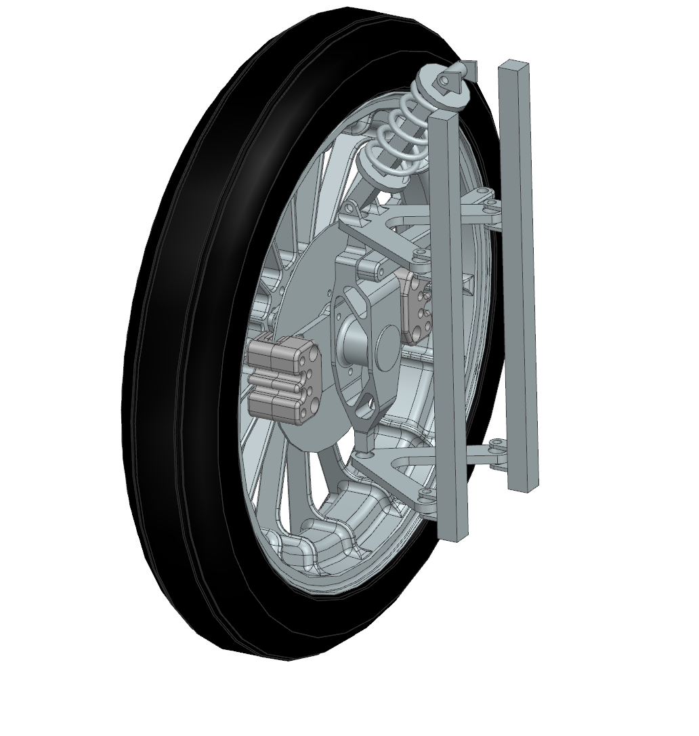
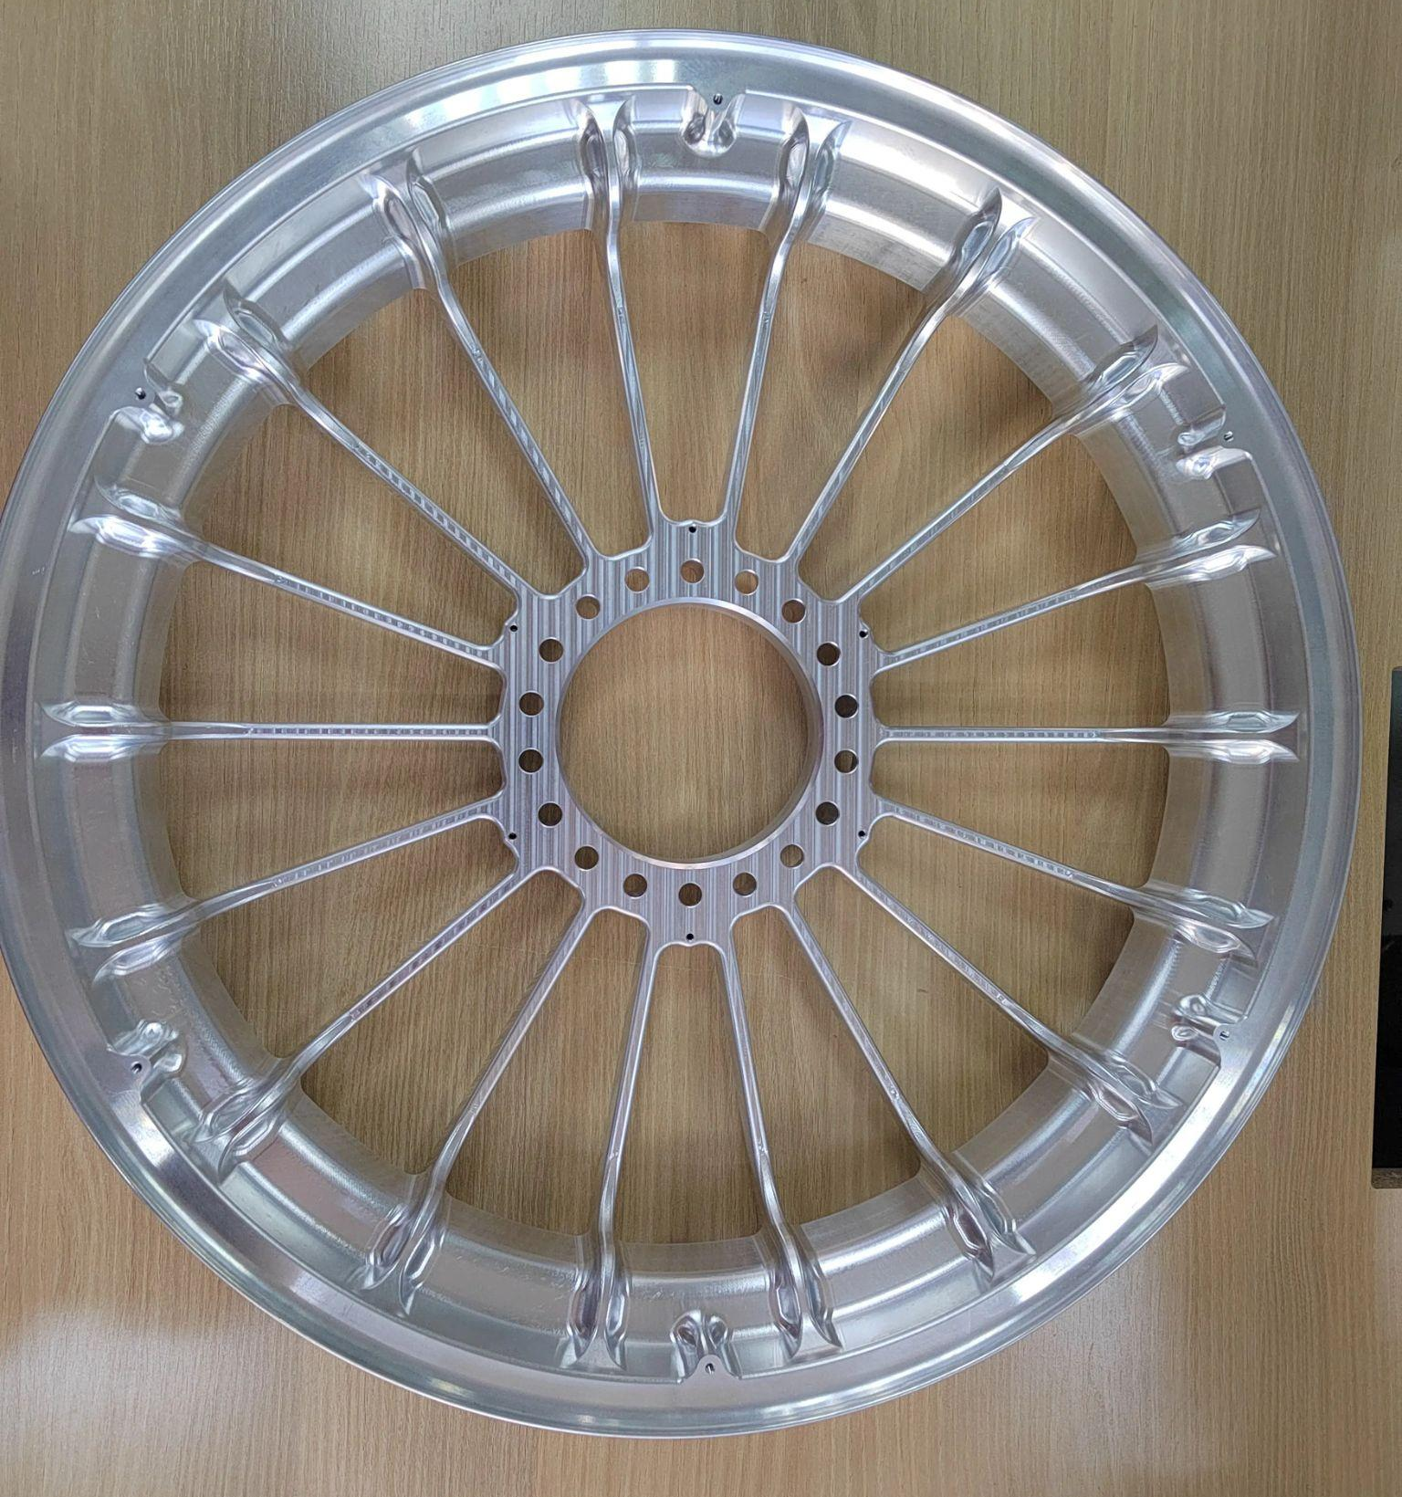
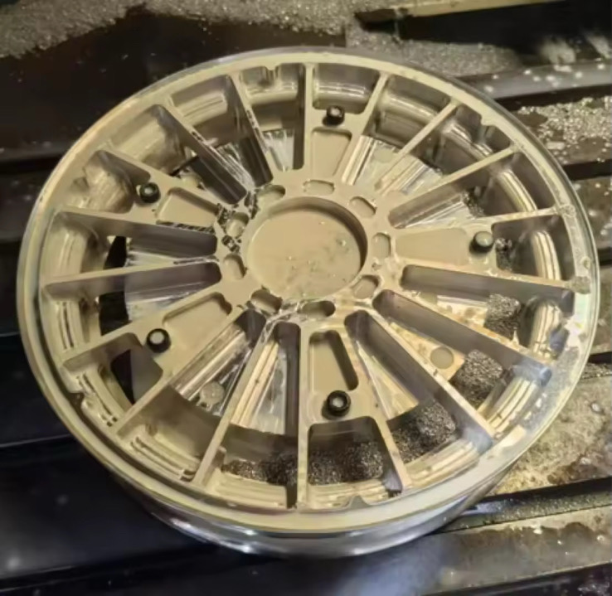
202X Cannonball Sun wheels

Slide 6
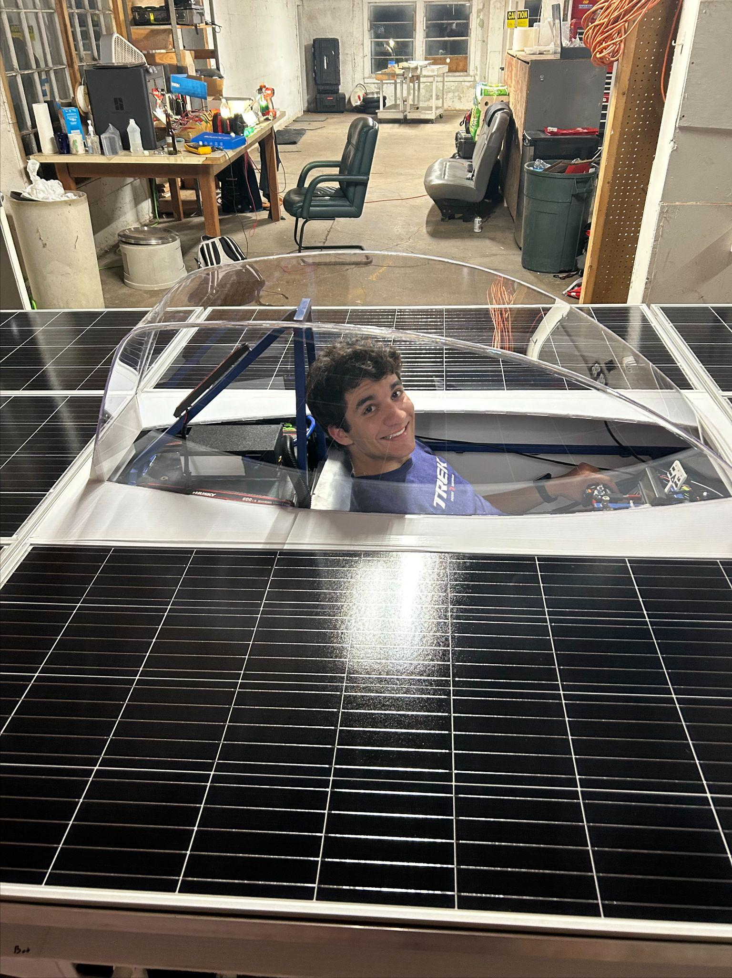
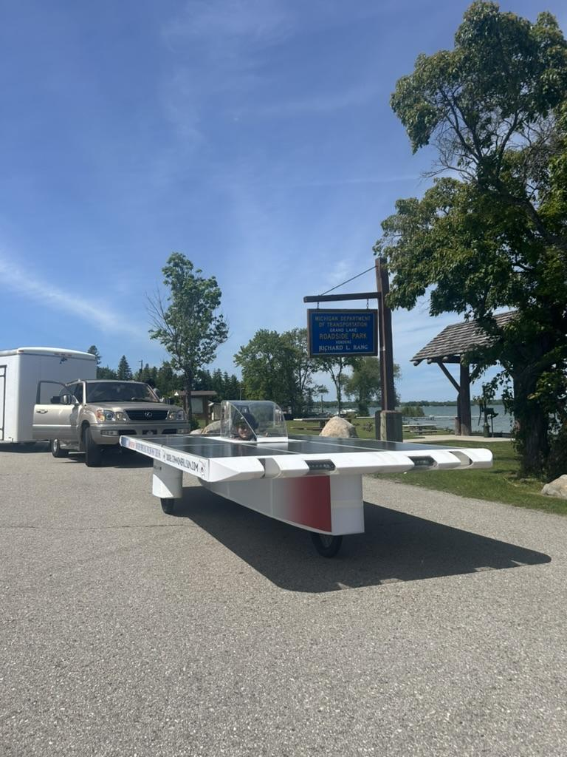
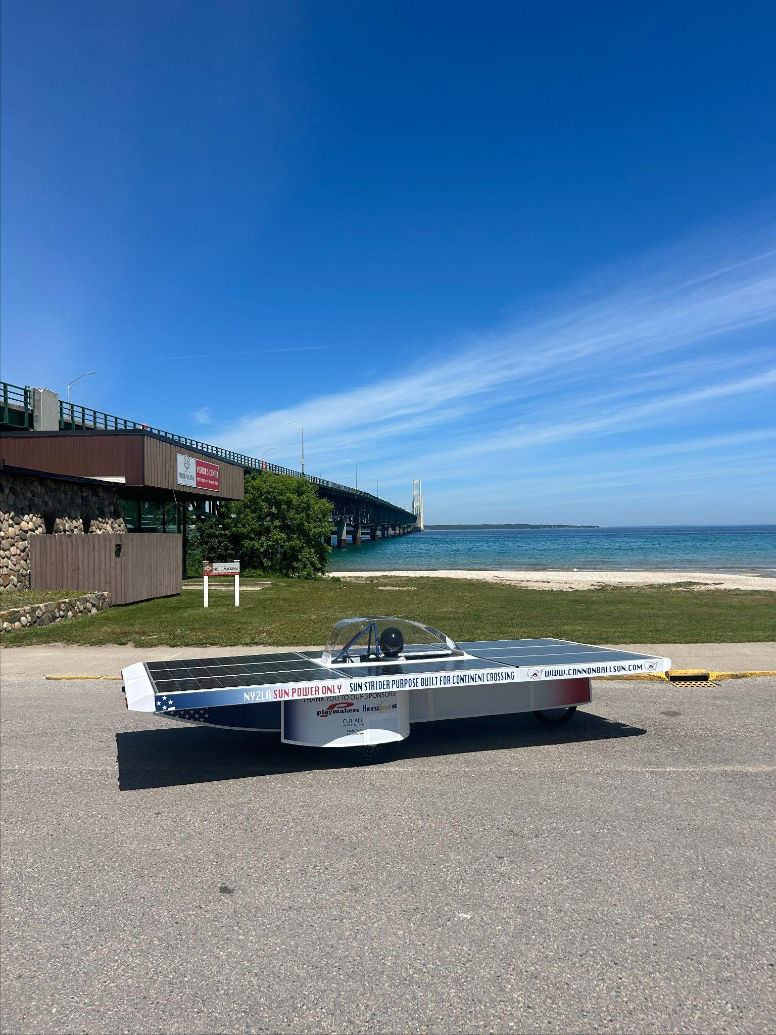

Slide 7
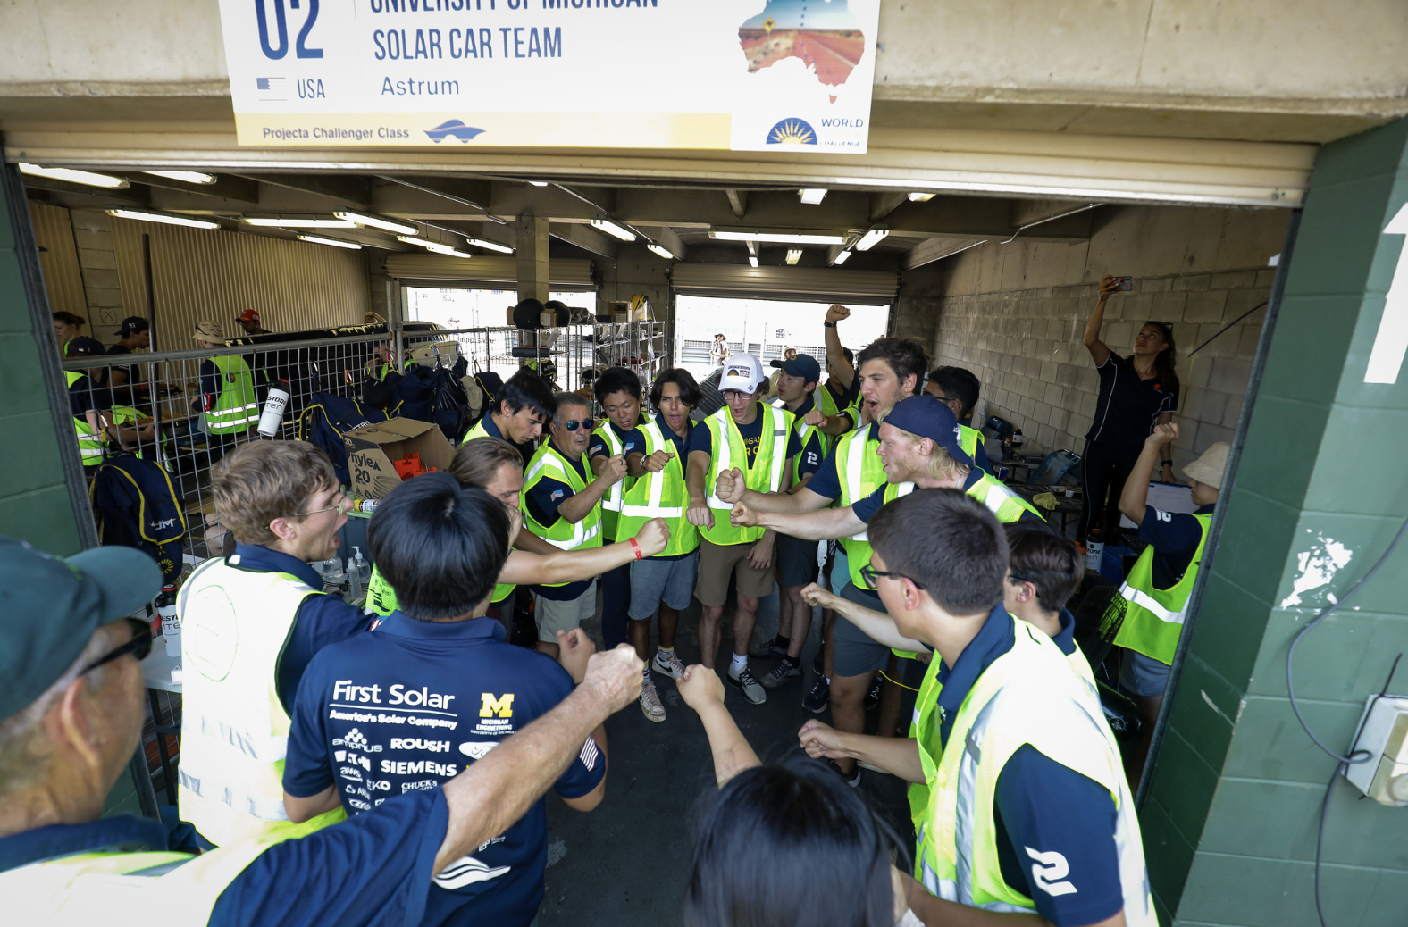
Introduction
None of these parts, accomplishments, or jobs would have been possible without a team
Shared the last few images to show what’s possible being a part of one of these projects. If you can can dream it, you can make it!
To be a successful team, you must define your team’s culture
Many teams (even successful teams!) struggle to recruit and retain effective team members and rely on a small handful to successfully move the project forward
It’s easy to get caught up in the car, but to have a car, first you must have a team
Generally the best team produces the best car, and is able to be more successful when it comes to actually driving the thing!
It is simply more fun if you have a good team!
Notes:
WSC “hugging” image

Slide 8
Context
Working with many teams and observing at the Solar Car Challenge
Teams struggle to:
Recruit team members
Retain team members

Slide 9
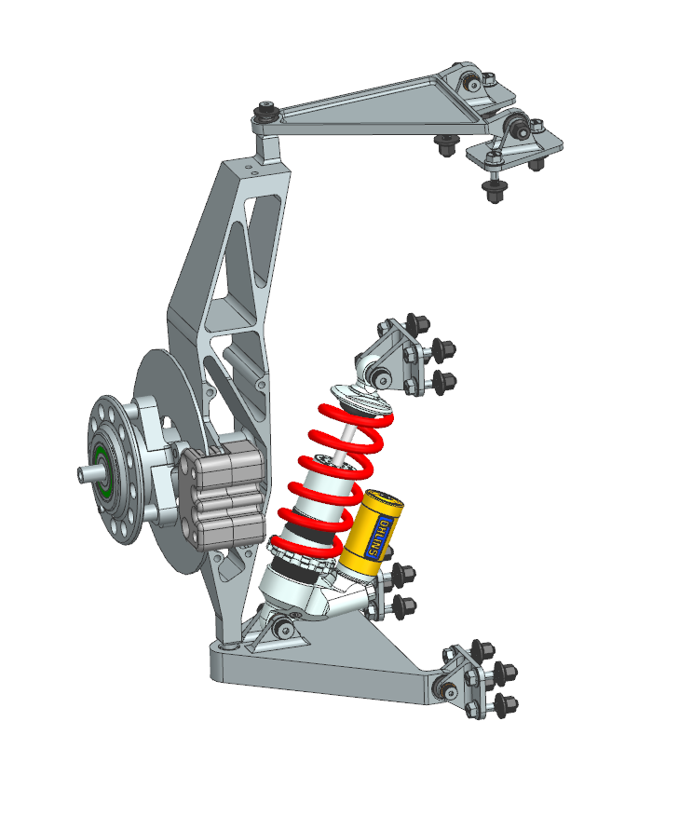
Why do people join a solar car team?
Experience: Solar car teams help members build resumes and gain skills like CAD, FEA, and programming.
Cool Factor: Designing, building, and racing solar cars is inspiring and unique.
Social: Opportunities to make and strengthen friendships.
Notes:
SpaceX rocket photo (with friends?)

Slide 10
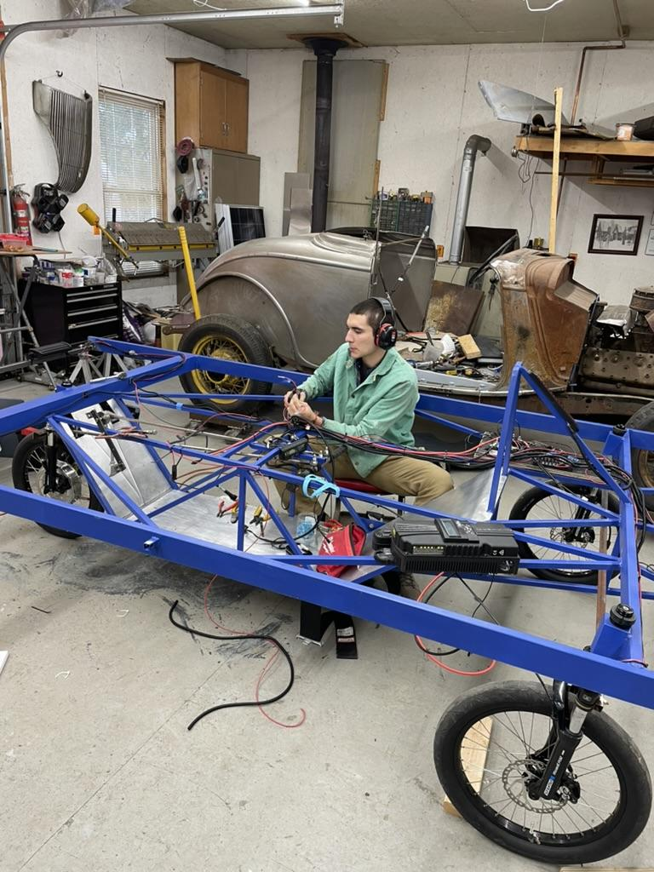
Experience
Learn to weld, solder, CAD, program, work on cars, etc.
Build your resume for college, jobs, technical schools, etc.
The ability to take something from an idea to a complete functional project is effectively what being an engineer is all about
I personally credit solar car for my acceptance into UM, my jobs at Tesla, and SpaceX
Notes:
Welding picture?

Slide 11
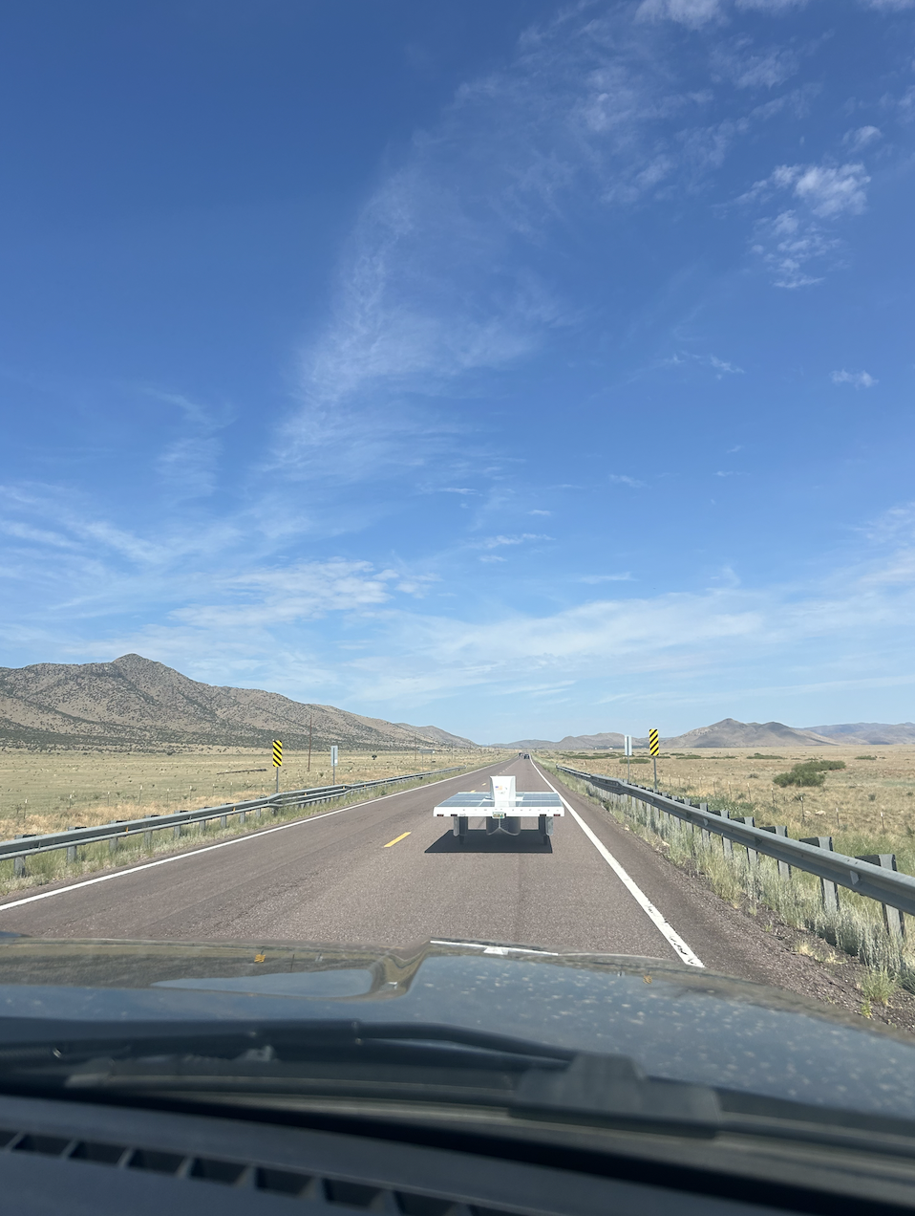
The cool factor of solar cars
Building your own car in high school or college is extremely cool
Being able to say you drove a race car around the Texas Motor Speedway is pretty awesome!
The fact that it’s possible to harness the power of the sun to drive hundreds or thousands of miles is still something that’s pretty hard for me to wrap my mind around
Going on adventures across the United States with your custom car is pretty sweet
I personally feel very fortunate to have been able to be a part of all the projects and teams I have been on
Notes:
Photo of Sun Strider somewhere cool?

Slide 12
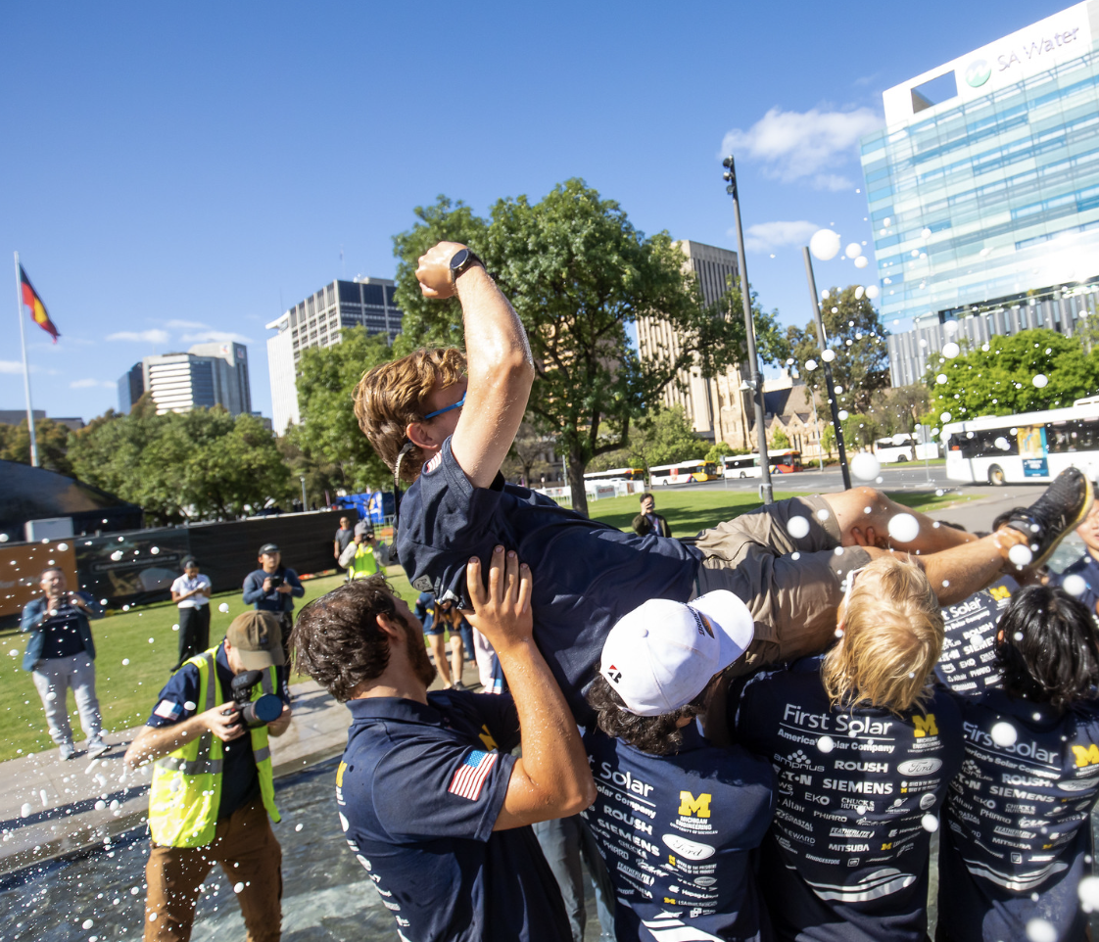
Importance of friendships
People are generally in two buckets when joining a solar car team
They already have a friend or two on the team
They are looking to make new friends
In my experience, if someone fails to makes friends or their friends quit the team they rarely stick around
If someone has made good friends on the team they are more likely to go the extra mile for the team and remain committed when it gets tough
Notes:
Fountain WSC photos

Slide 13
Summary: Motivations for joining a team
Consistently working to remind members why they joined the team will help retain them
Experience
Teach skills like CAD, FEA, or programming to enhance resumes.
Assign meaningful projects that can be discussed in college or job applications.
Provide hands-on opportunities, like building or testing parts of the car.
Encourage members to set personal learning goals related to the team.
Showcase alum successes, emphasizing how the experience contributed to their achievements.
It’s Plain Cool
Show videos from previous solar car races before meetings to inspire members.
Emphasize the unique opportunity of building and racing a solar car.
Share updates on team milestones to keep the bigger picture in mind.
Create an engaging social media presence to showcase the team’s work.
Plan an annual unveiling or demo event for the car to celebrate progress.
Friends
Foster an inclusive atmosphere by welcoming all ideas and feedback.
Start meetings with an icebreaker or a quick team-building challenge.
Establish mentor-mentee relationships for peer guidance.
Create a group chat to encourage connection outside meetings.
Organize small group activities

Slide 14
Why people stay?
Feeling Valued: Recognition through meetings, feedback, and using their ideas.
Meaningful Contribution: Clear, manageable projects with defined goals.
Strong Social Bonds: Friendships encourage commitment.
From a high level people stay on the team if they enjoy it!

Slide 15
Why is it important your retain team members?
Knowledge transfer from year to year
For almost any challenge in engineering it’s almost impossible to get it right the first time
It takes time to learn specific skills and knowledge specific to solar car
At UM, I always say it takes two years before team members really “hit their stride” or can truly impact the team in a meaningful way
Older more experienced team members can mentor younger team members

Slide 16
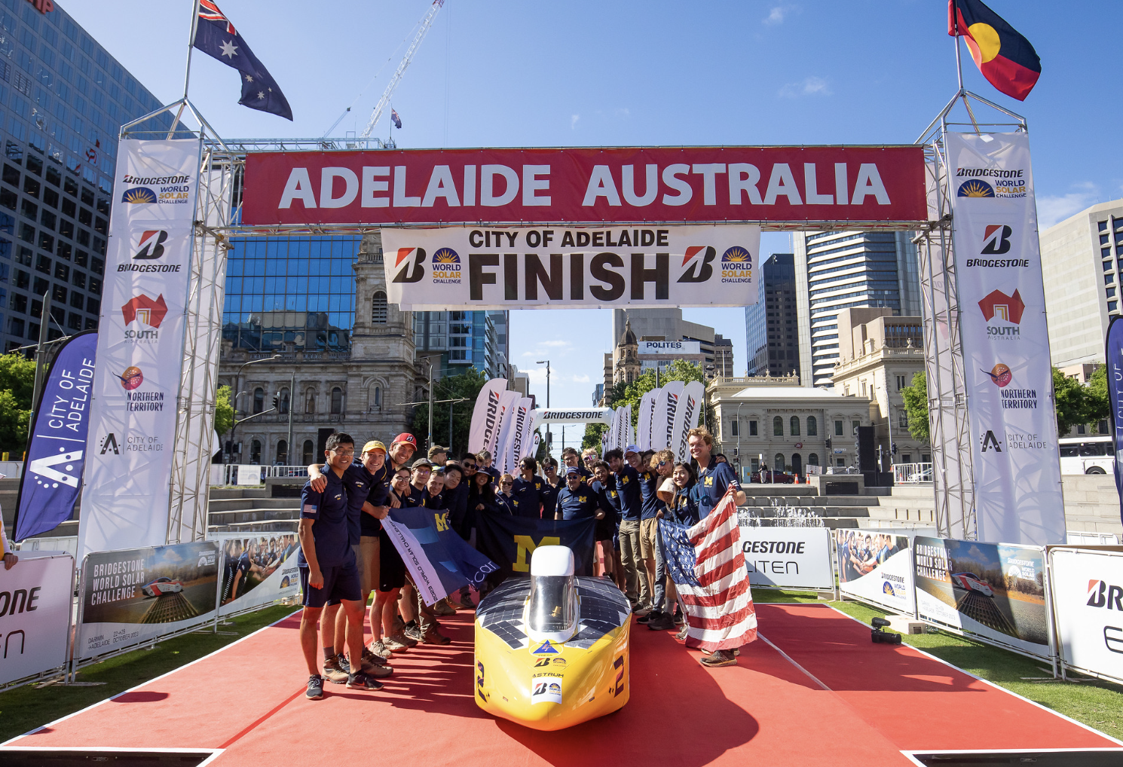
Feeling valued
Retention relies heavily on whether members feel valued and respected.
Unlike sports, solar car challenges don’t offer frequent chances for competition or accolades, so a sense of respect and recognition becomes even more critical.
If team members feel their time and effort are unappreciated, they are unlikely to stay, even if they contribute meaningfully and have friends on the team.
Notes:
WSC cooking photos?

Slide 17
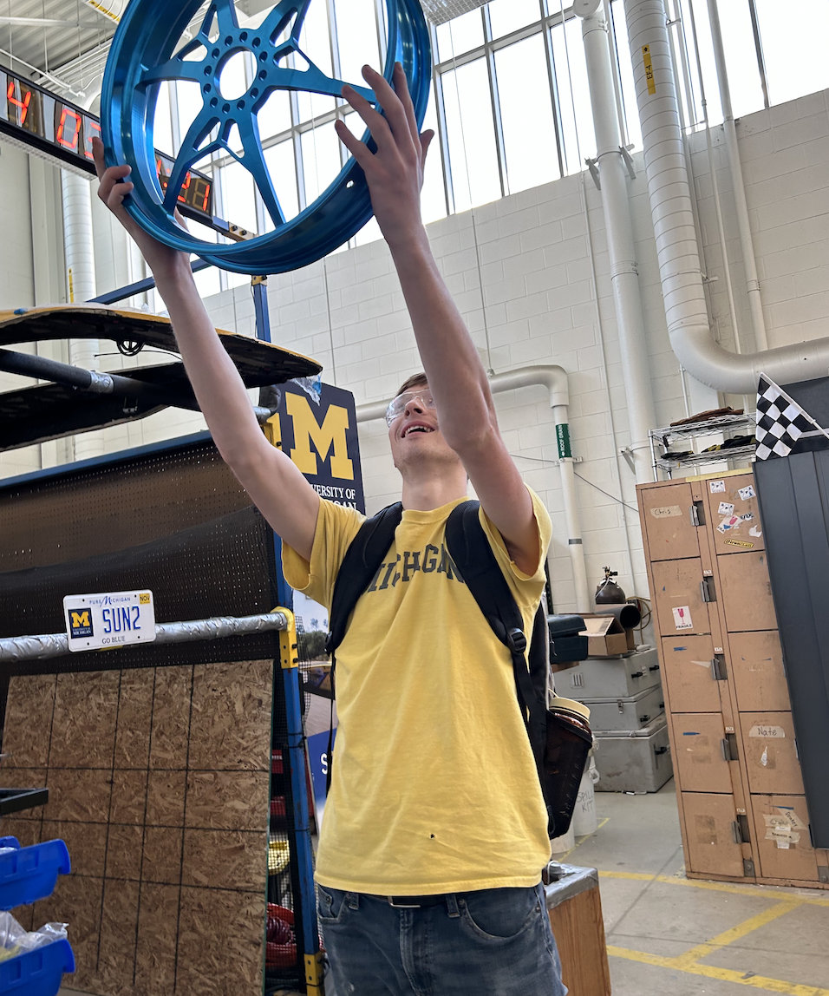
Contributing meaningfully
Meaningful Contribution:
Assigning meaningful, achievable projects with precise requirements and regular check-ins can ensure success.
Each project should be framed with the necessary tools and resources. Expectations should be defined so members know what success looks like.
It’s great if you like being on the team and feel valued and respected but if you don’t meaningfully contribute it’s social hour not solar car
Once a project is assigned, it’s essential not to reassign it without thoughtful consideration. Members need to feel confident that their contributions are valued and will be used by the team.
Meaningful projects and experiences are what actually matter

Slide 18
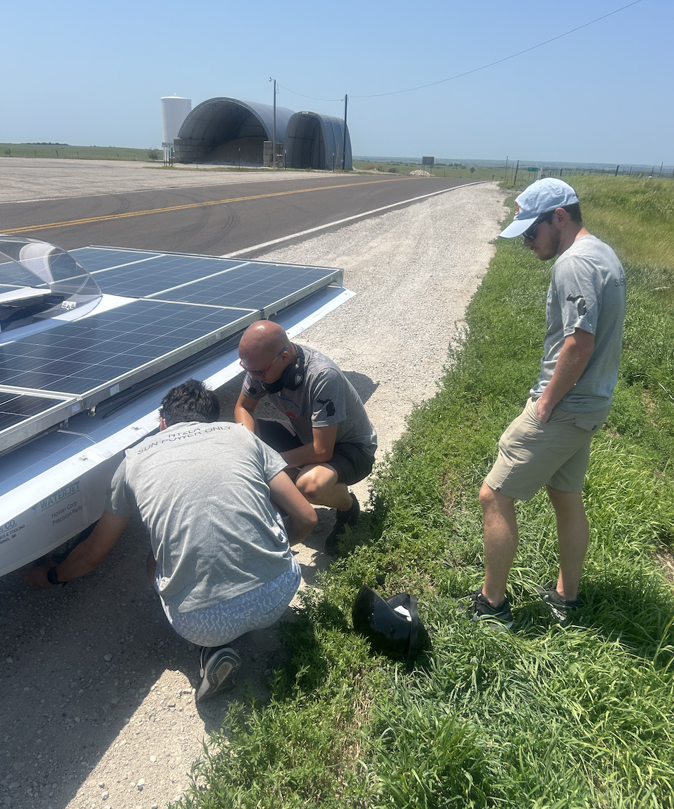
Fostering friendships
Building Friendships: For most members, friendships are the core of retention. Not all parts are fun about solar car; challenging or tedious tasks can be hard to stay committed to without strong social ties. Not everyone will be best friends, but friendships build solar cars.
To build these connections, team leaders should facilitate opportunities for social interaction, from simple activities to more hands-on team challenges. If members feel connected to each other as friends, they’re more likely to stay motivated and contribute meaningfully. People are willing to go the extra mile for friends.
Notes:
Fun team pic with the CBS boys?

Slide 19
Summary: Keys to retention
Feel Valued and Respected
Assign achievable, meaningful projects that members can complete.
Regularly acknowledge individual contributions in team meetings.
Schedule semi regular 1:1 meetings to understand team members' concerns and goals.
Use member ideas in decision-making and project planning.
Provide constructive feedback that emphasizes growth and improvement.
Contribute Meaningfully
Clearly define project goals and success criteria.
Offer training sessions or resources to equip members with the necessary skills.
Assign projects aligned with each member’s interests.
Maintain regular check-ins to support progress and answer questions.
Avoid reassigning tasks without careful consideration to ensure members feel ownership.
Foster Friendships
Start meetings with a quick bonding activity, like a spaghetti tower or paper airplane challenge.
Organize occasional social events, such as team dinners or group outings.
Set up name games or introductions to help new members learn everyone’s names and about themselves.
Encourage collaboration by pairing members who do not know one another well on projects or small tasks.
Use small group challenges (like a scavenger hunt or mini-design contest) to foster camaraderie.

Slide 20
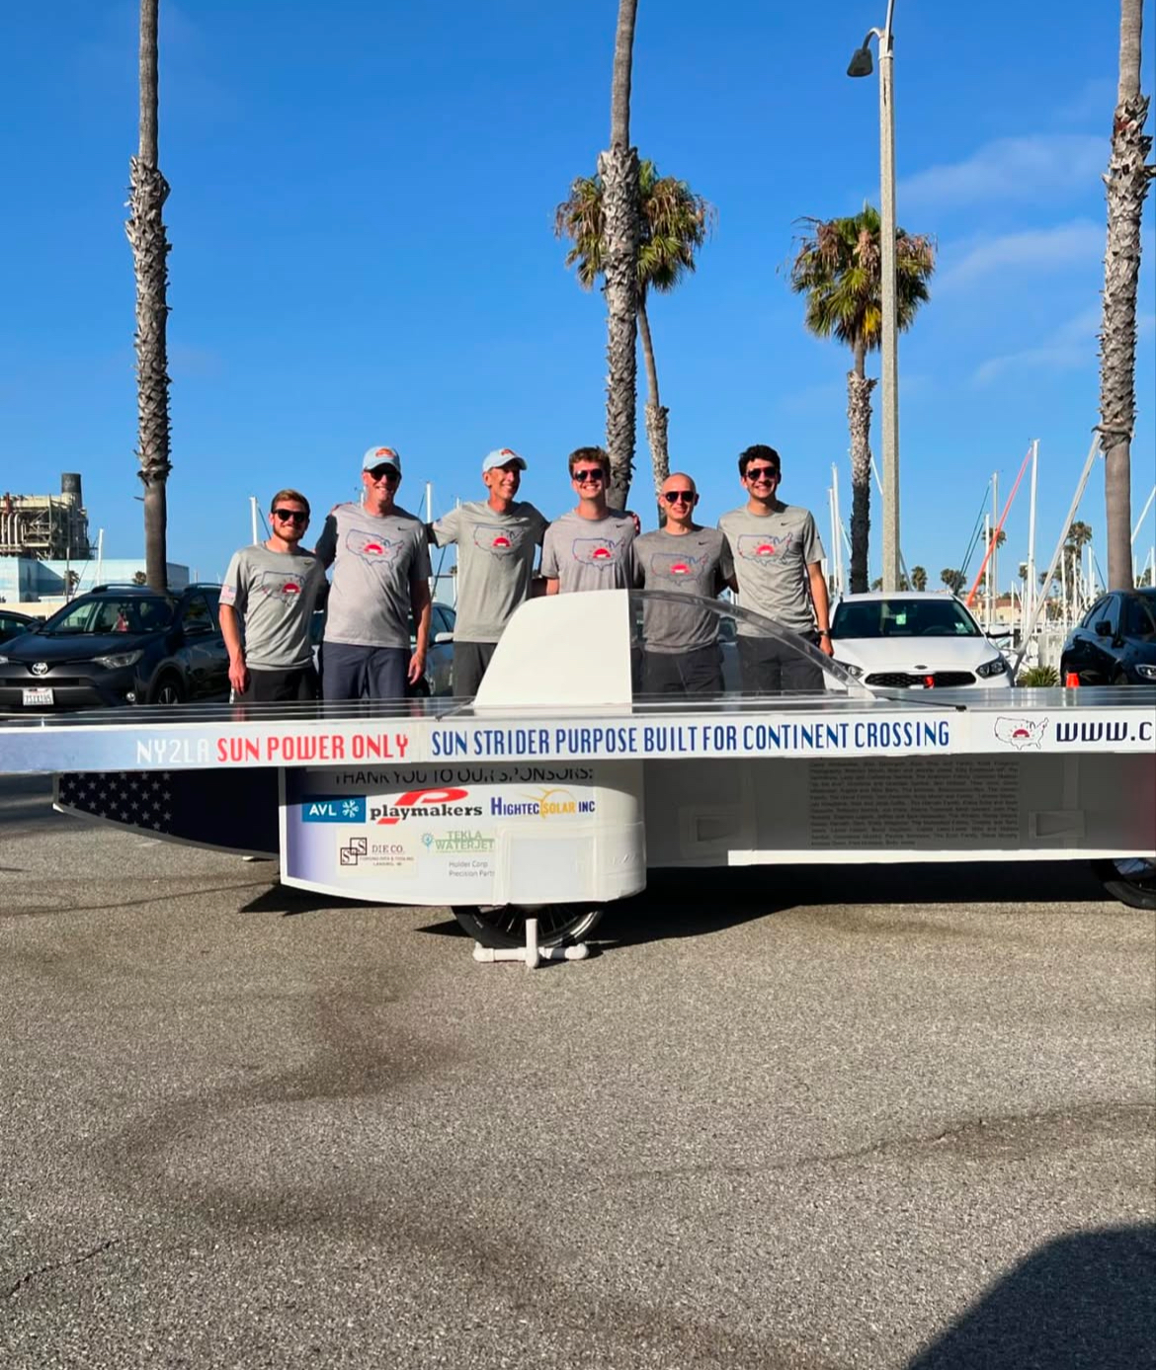
Quality over quantity
Retention and productivity on a solar car team hinge on ensuring members feel respected, make meaningful contributions, and form genuine friendships. Importantly, it’s essential to remember that quality beats quantity. Five committed members can often contribute more than twenty less dedicated individuals. Focusing on developing a core group of “rock stars” who excel at their roles can create a foundation for future growth. These “rock stars” can mentor new members, helping to sustain and strengthen the team culture. Committed team members who stay for all four years are what build teams.
Notes:
80 / 20 rule photo?

Slide 21
You get out what you put into it

Slide 22
It’s not always glorious

Slide 23
It’s not always easy

Slide 24
It’s not always fun

Slide 25
You can make it happen

Slide 26
It’s so worth it

Slide 27
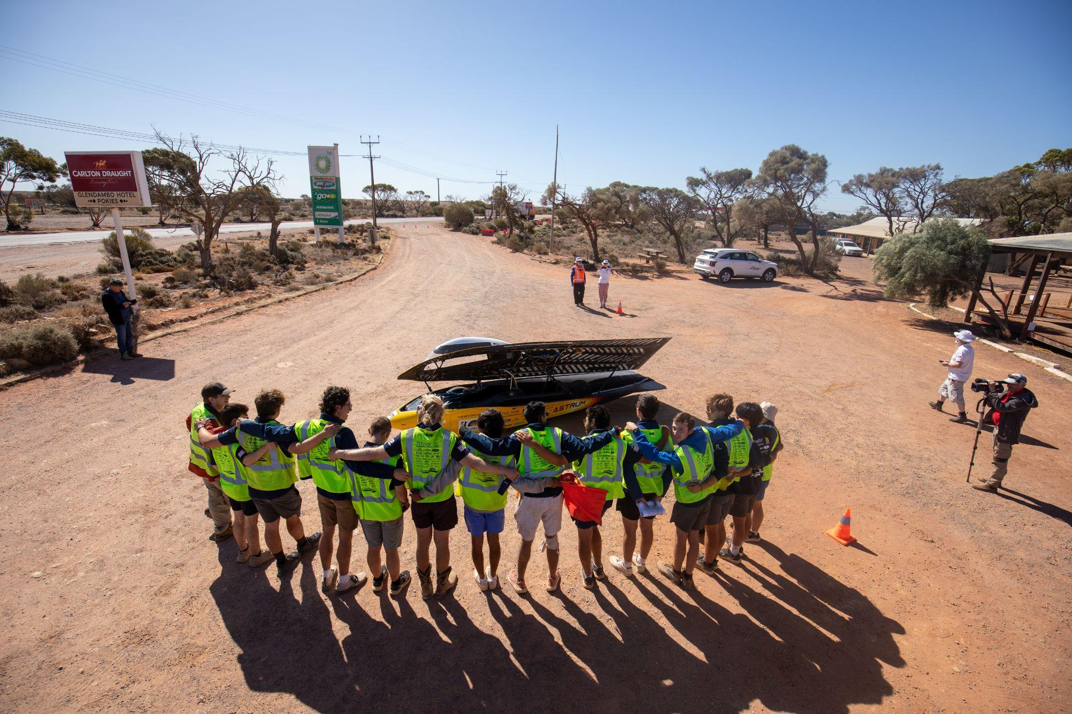
Summary: Consciously build your culture
Why join?
Gaining Experience
Cool Factor
Friends
Consistently working to remind members why they joined the team will help retain them
Why stick around?
Feeling Valued
Meaningful Contribution
Strong Social Bonds
Quality > Quality
Retain your team members and help them be rock stars

Slide 28
Questions?
Contact Information:
Will Jones
Phone: 517-347-1263
Email: wbjones@umich.edu
I would love to hear from any teams!

